Slide 1

WIPRO NGA Program – 25SUB4530_CP_JAVA
Capstone Project Presentation – 9th Feb & 10th Feb 2026
Project Title – Task/To-Do Management Application
Presented by – Devara Vasmitha
Dole Madhu Sri
www.rpsconsulting.in

Slide 2

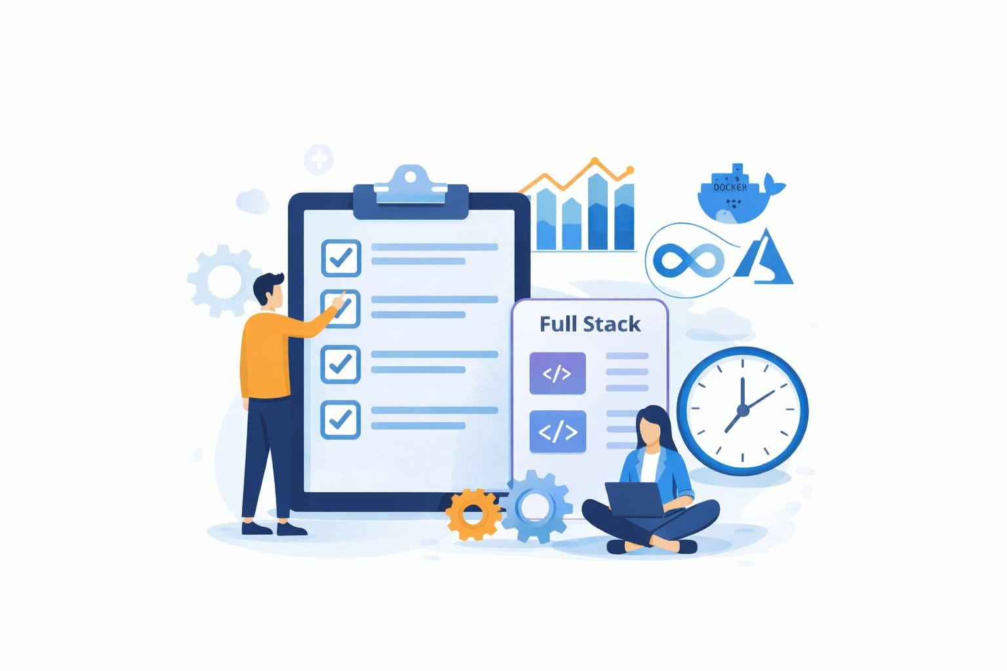

Objective of the Project
Improve task organization and productivity
Provide clear visibility of tasks
Enable users to manage tasks efficiently
Demonstrate full-stack development skills
Implement DevOps concepts like Docker and Azure
2024 - RPS Consulting all rights reserved

Slide 3

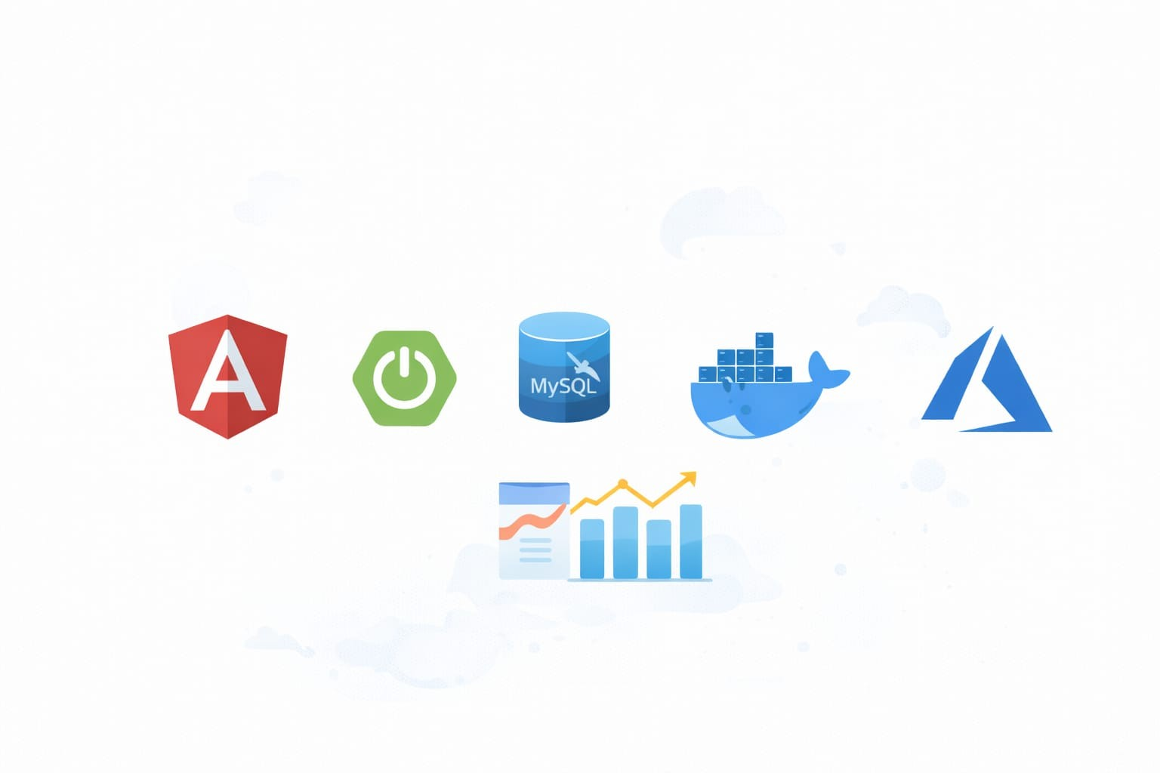
Technology Stack
Frontend:
Angular
HTML, CSS, TypeScript
Backend:
Spring Boot
Spring Data JPA
Database:
MySQL
DevOps & Cloud:
Docker
Azure Container Instances
2024 - RPS Consulting all rights reserved

Slide 4
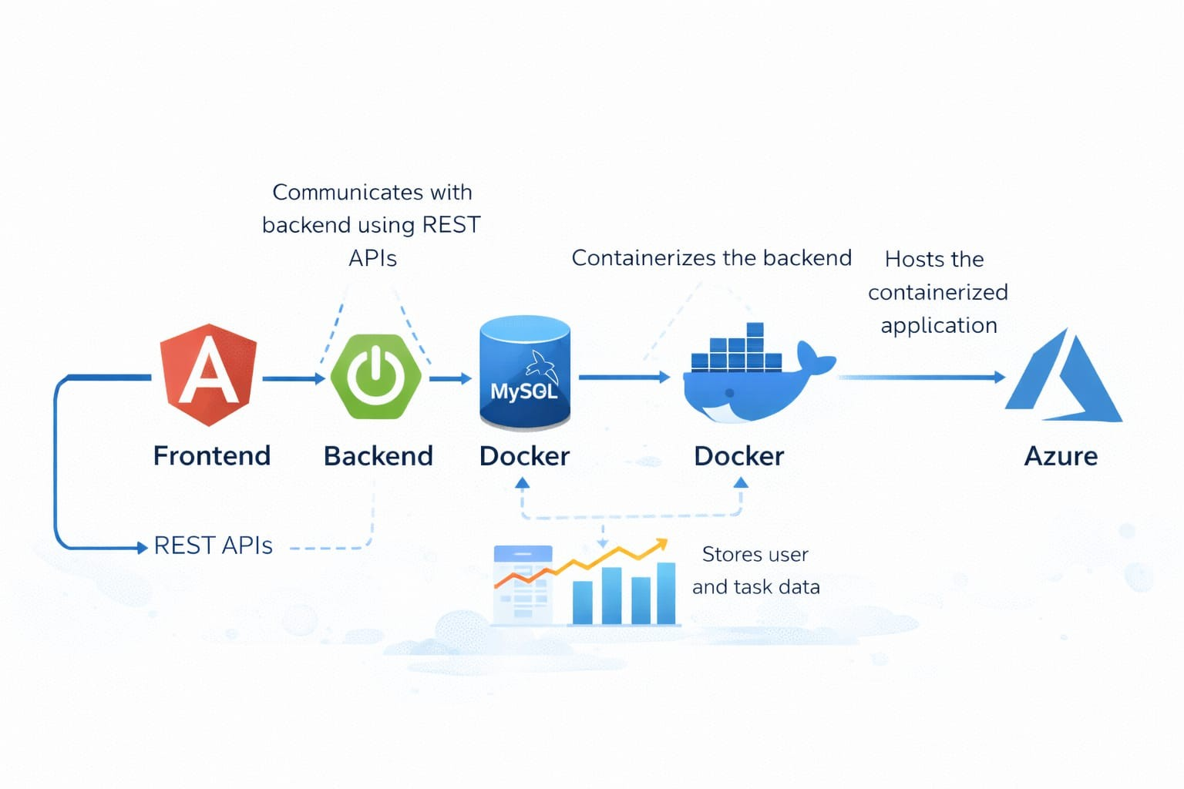
System Architecture
Angular frontend communicates with backend using REST APIs
Spring Boot backend handles business logic
Spring Data JPA manages database operations
MySQL stores user and task data
Docker containerizes the backend
Azure hosts the containerized application
2024 - RPS Consulting all rights reserved

Slide 5
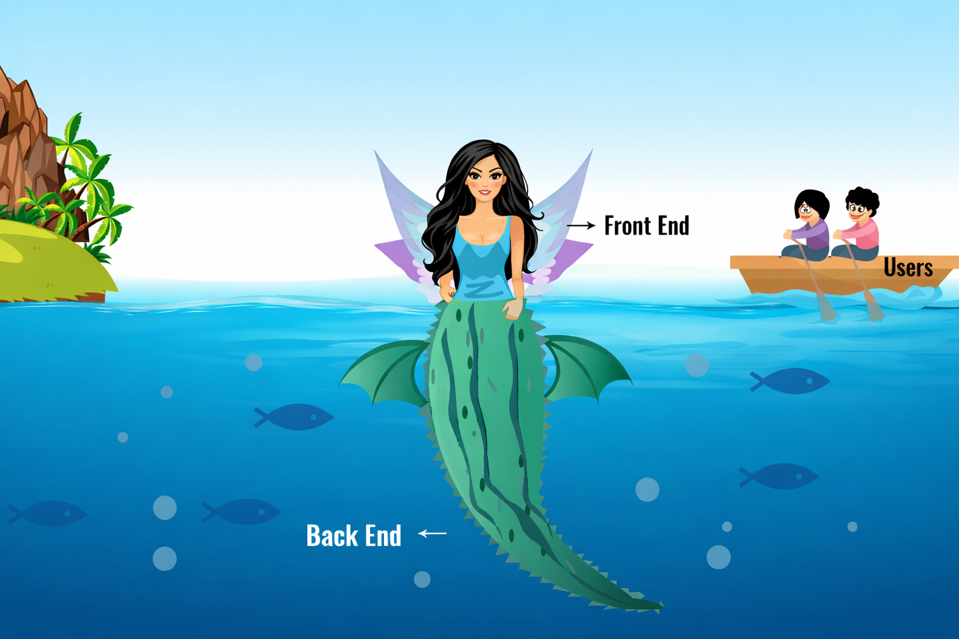

Slide 6

Frontend Implementation
Developed using Angular
Responsive UI with clean layout
Forms for task creation and update
Filters for task status
Includes filters to view tasks based on status
Communicates with backend using HttpClient
Ensues smooth user interaction and real-time data updates
2024 - RPS Consulting all rights reserved

Slide 7
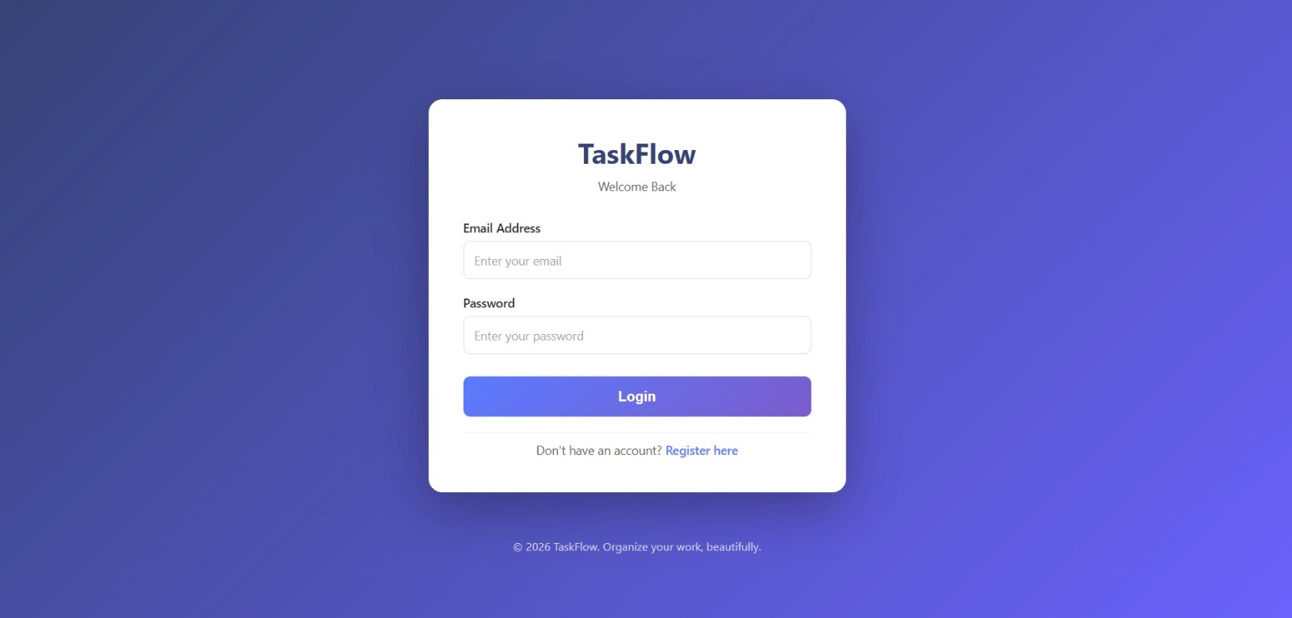
Core Functionalities
User login and authentication
Create new tasks
Edit existing tasks
Delete tasks
Mark tasks as Completed / Pending
Filter tasks by status
Sort tasks by due date
2024 - RPS Consulting all rights reserved

Slide 8
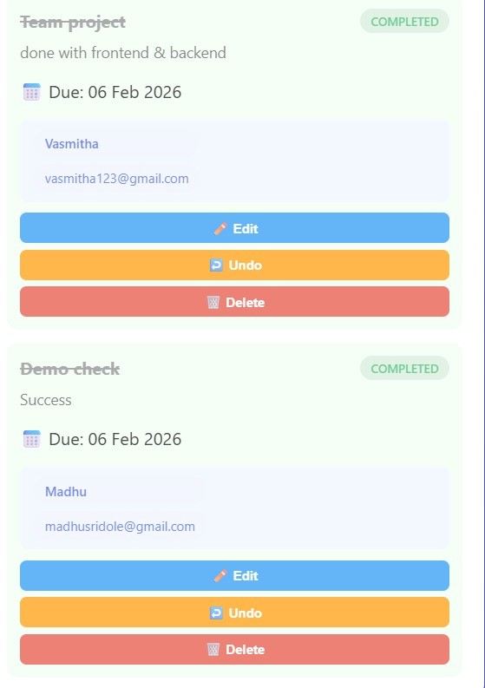
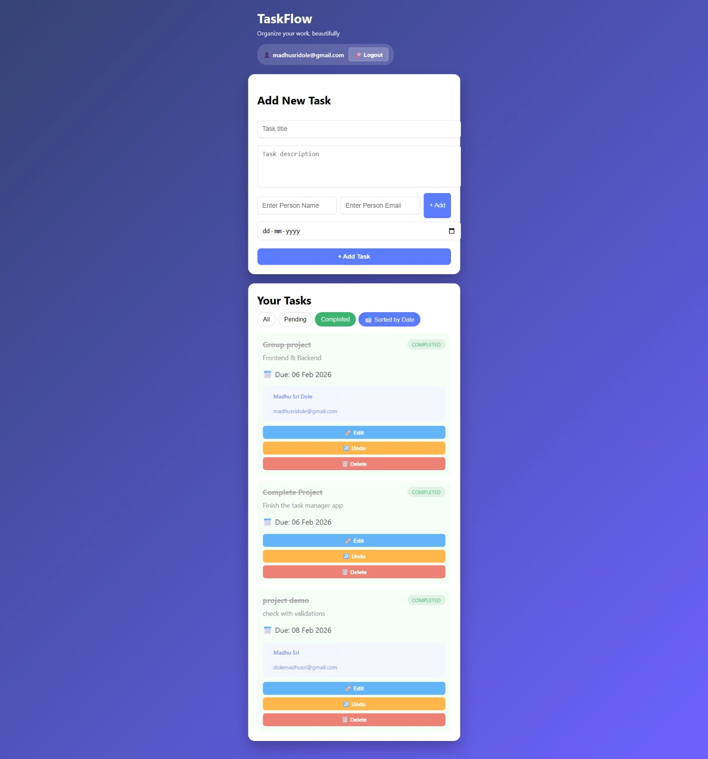
Outputs:

Slide 9
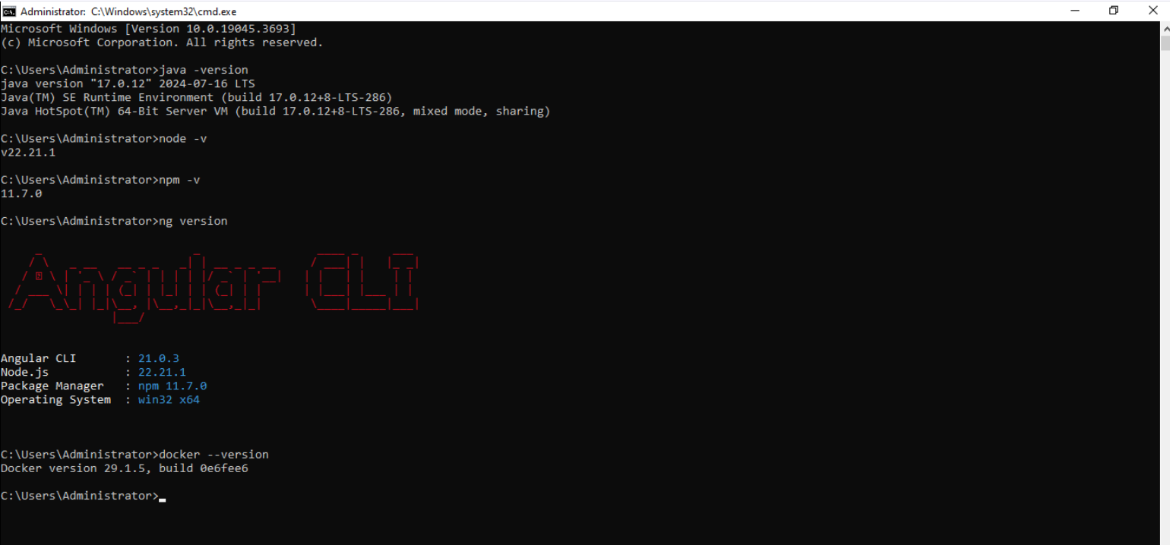
Backend and Frontend Versions
2024 - RPS Consulting all rights reserved

Slide 10
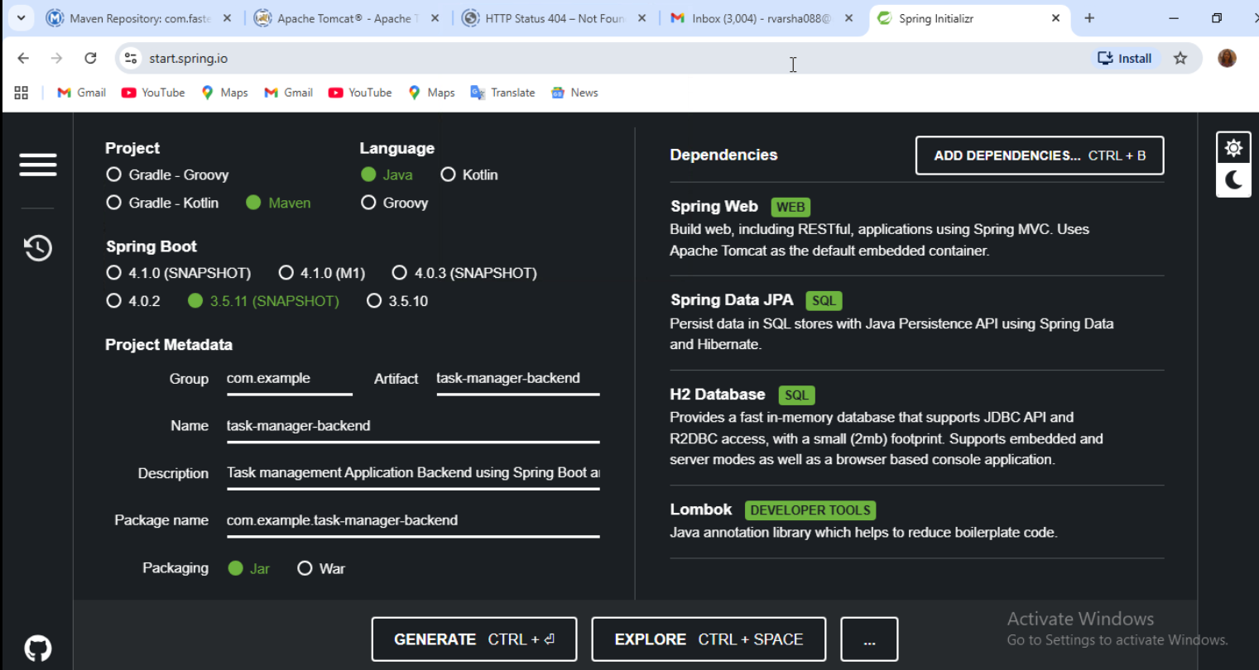
Backend Implementation
2024 - RPS Consulting all rights reserved

Slide 11
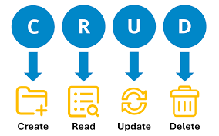
Backend Implementation
Developed using Spring Boot
REST APIs created for all CRUD operations
Controllers handle HTTP requests
Services contain business logic
Repositories interact with database
Uses Spring Data JPA for persistence
2024 - RPS Consulting all rights reserved

Slide 12
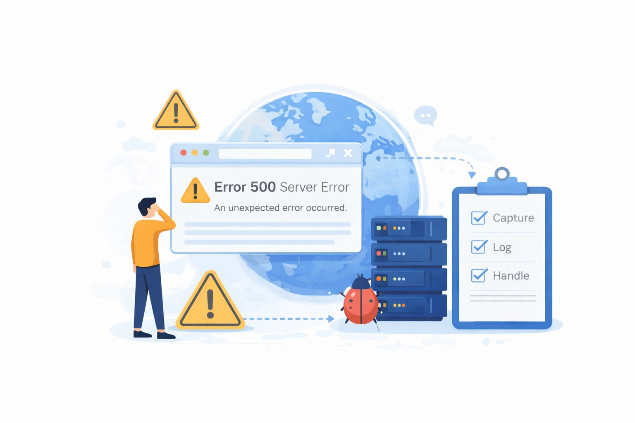
Global Exception
Implemented global exception handling using @ControllerAdvice in spring boot
Handles runtime exceptions across all REST APIs in the Task Management Application.
Provides meaningful error messages
Prevents application crash
Improves backend reliability ,debugging and overall maintainability
2024 - RPS Consulting all rights reserved

Slide 13
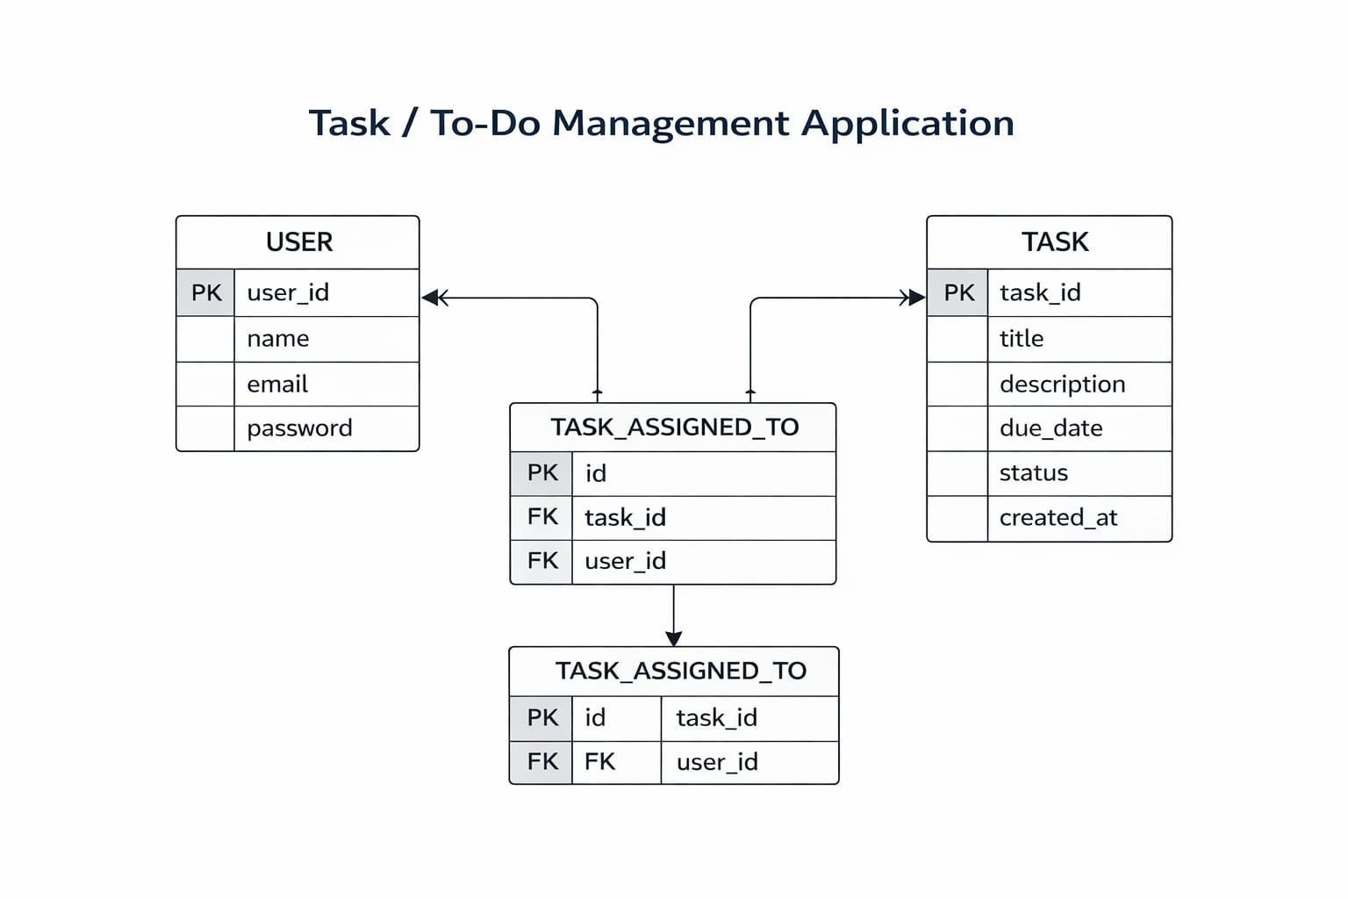
Database Design
Tables Used:
User
Task
Task_Assigned_To
Features:
One-to-many relationship (User → Tasks)
Supports task assignment using Task_Assigned_To mapping table
Stores task title, description, due date, and status
Uses MySQL for persistent and relational storage
2024 - RPS Consulting all rights reserved

Slide 14
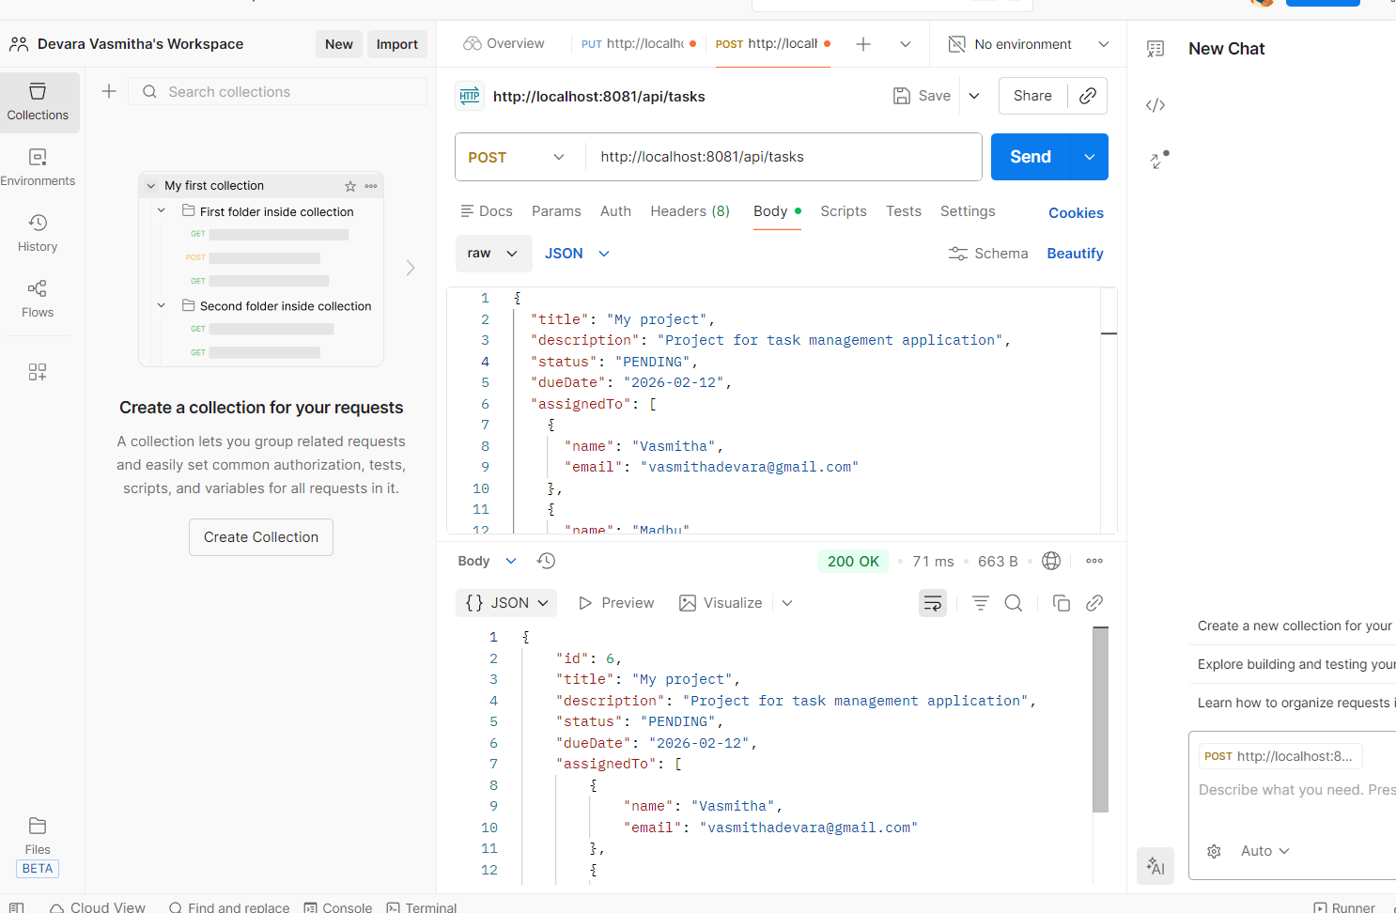

REST API EndPoints
POST /api/auth/login – User login
2024 - RPS Consulting all rights reserved

Slide 15
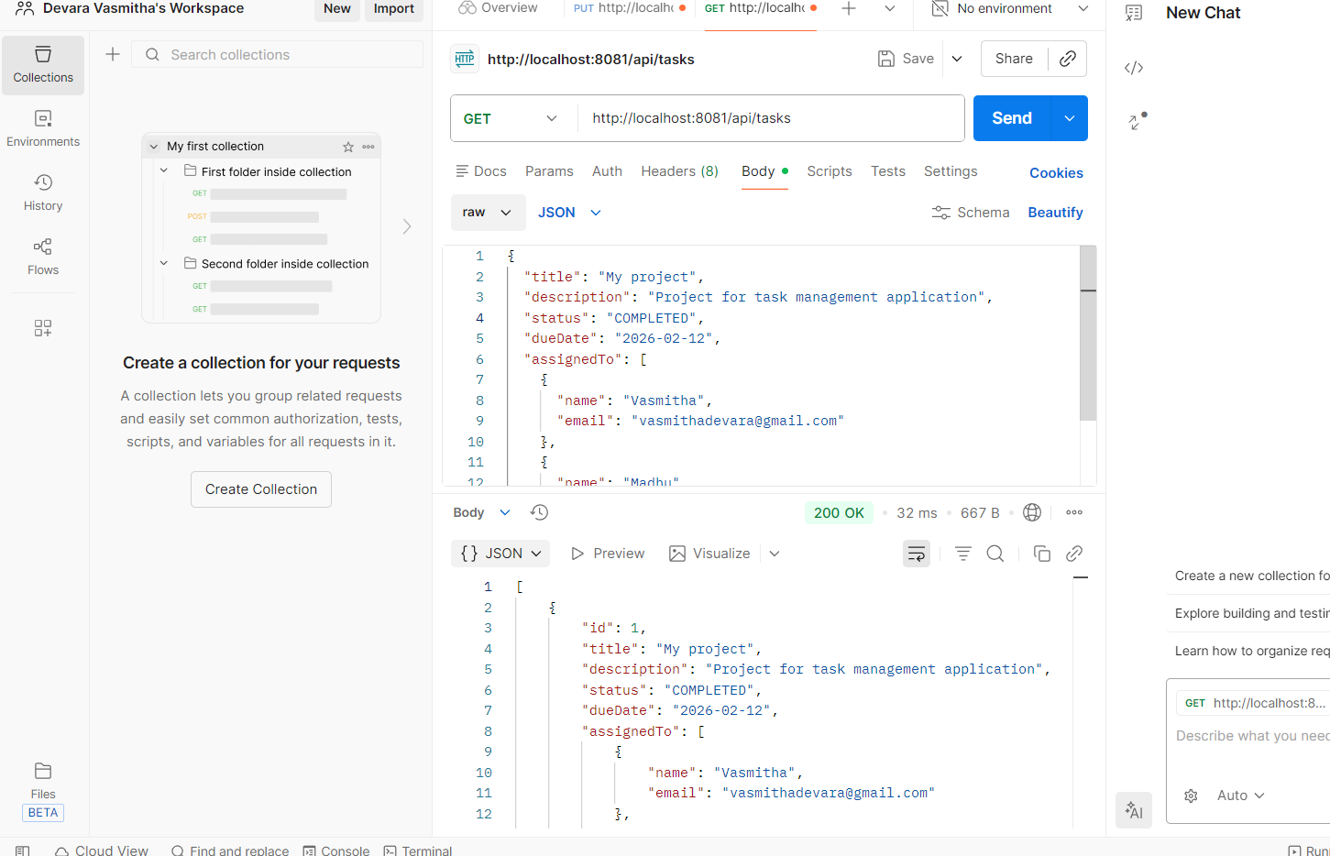

REST API EndPoints
GET /api/task/user – Fetch tasks
2024 - RPS Consulting all rights reserved

Slide 16
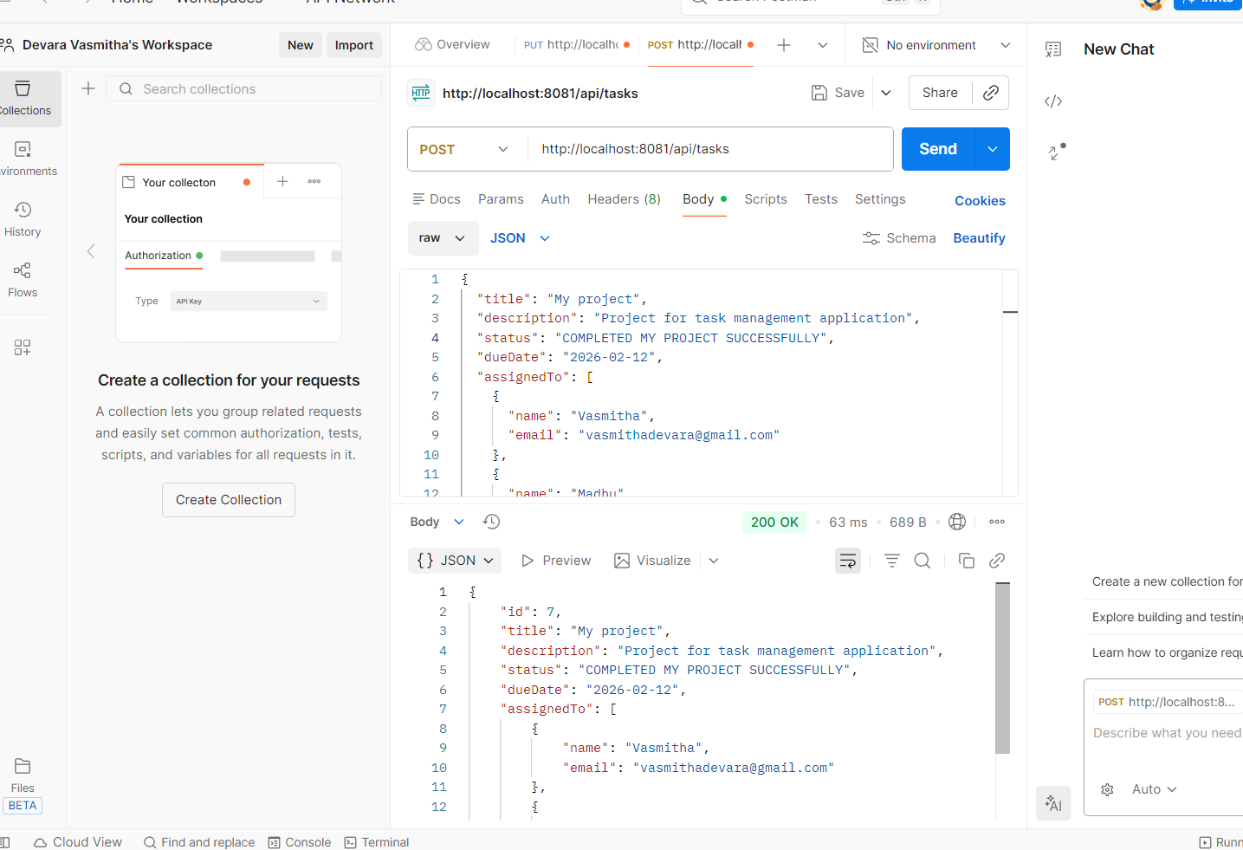

REST API EndPoints
POST GET /api/task/user – Add task
2024 - RPS Consulting all rights reserved

Slide 17
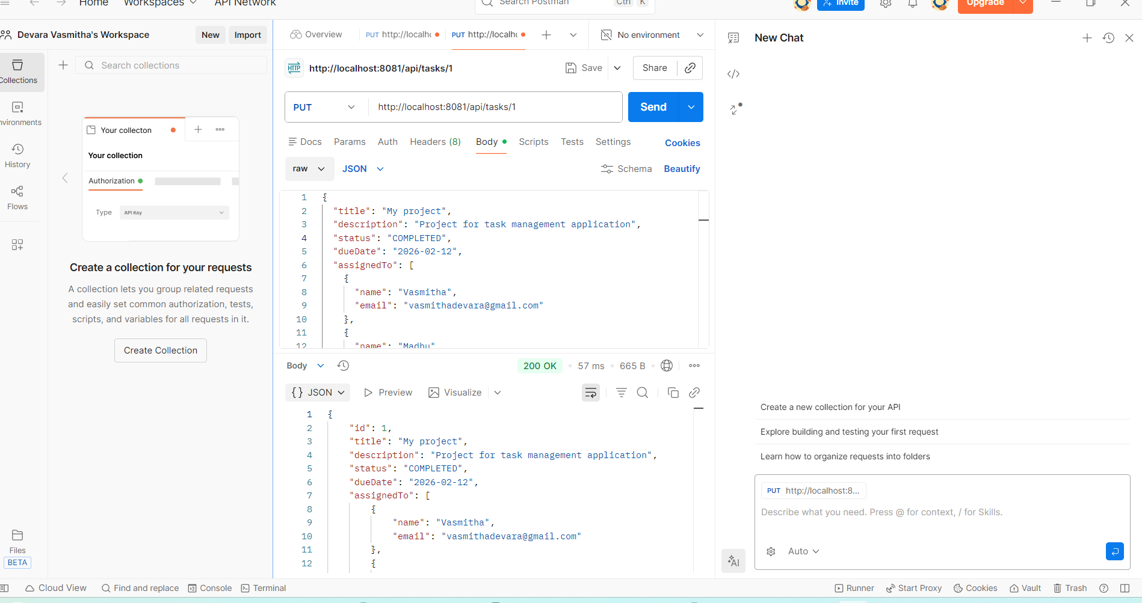
REST API EndPoints
PUT /api/task/user/{taskId} – Update task
2024 - RPS Consulting all rights reserved

Slide 18
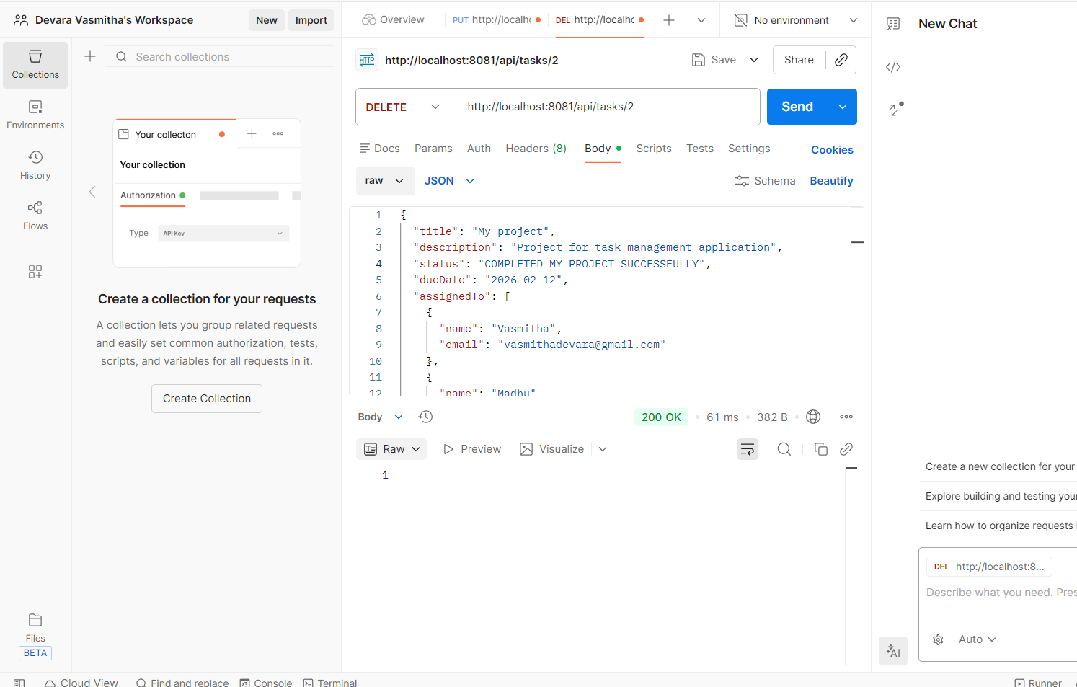
REST API End Points
DELETE /api/tasks/{taskId}– Delete task
2024 - RPS Consulting all rights reserved

Slide 19
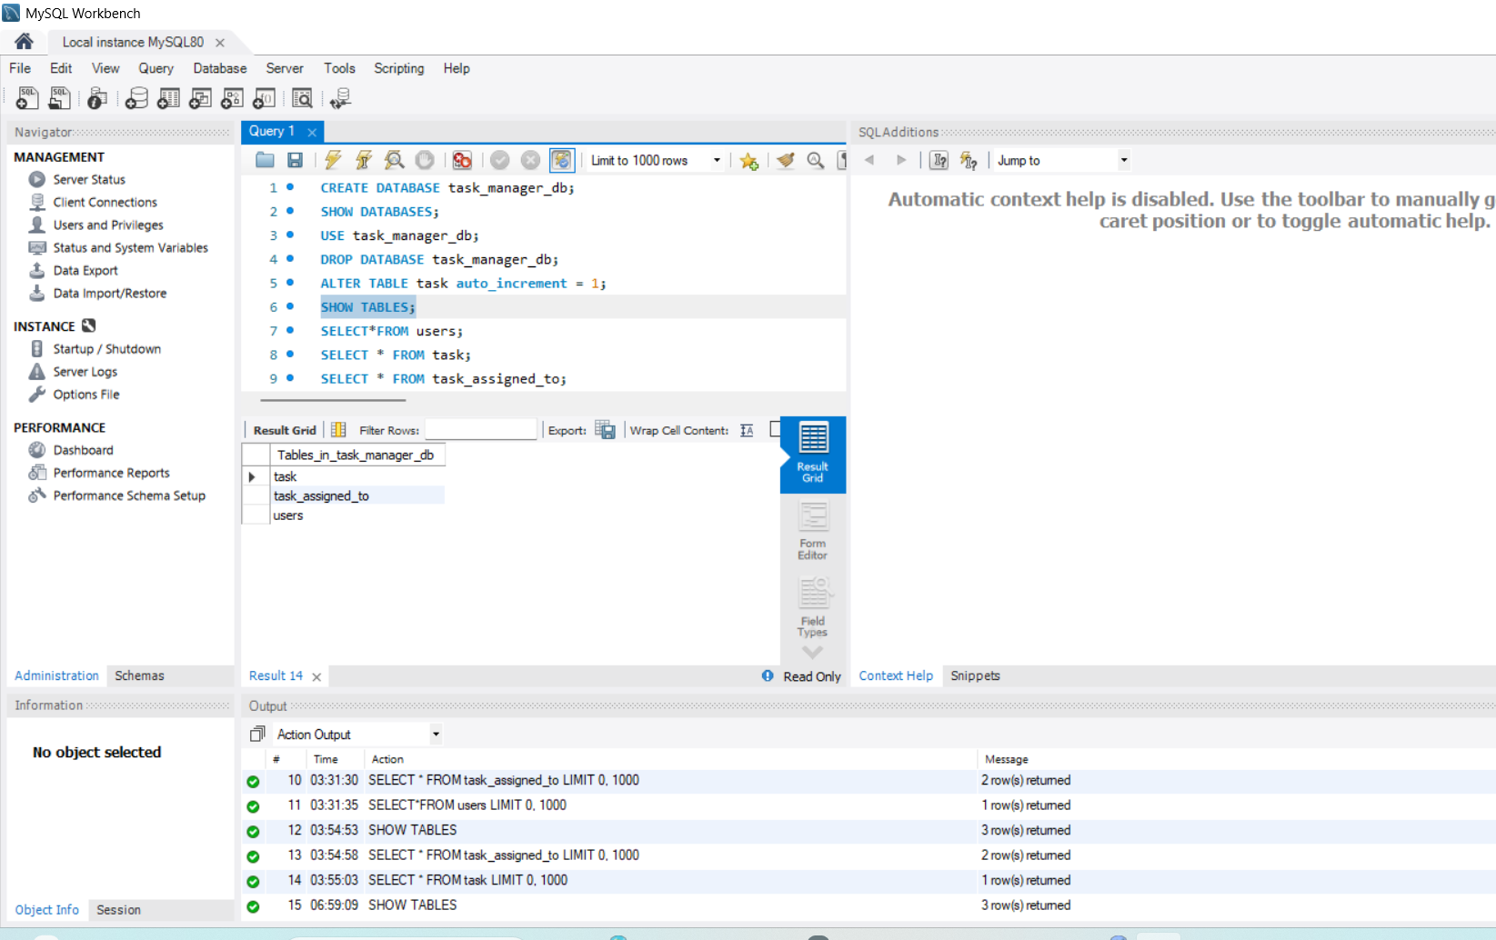
Backend Implementation
2024 - RPS Consulting all rights reserved

Slide 20
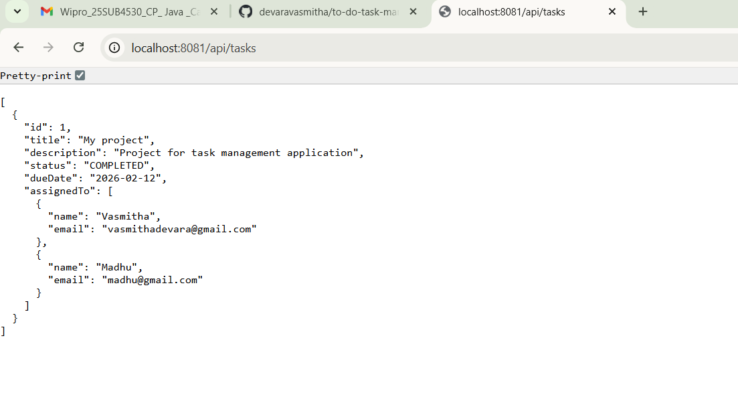
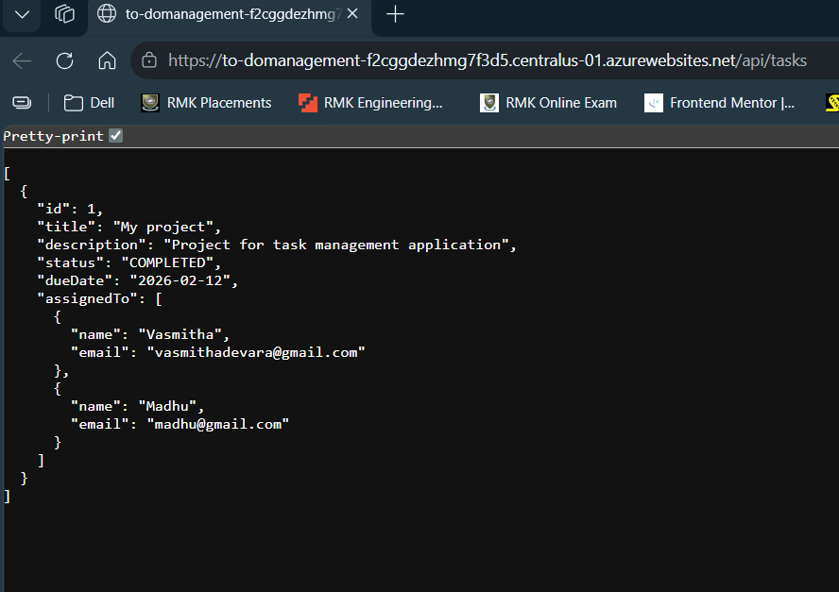
Output:

Slide 21
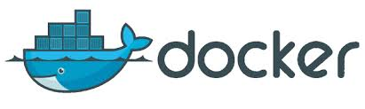
“Docker is a containerization platform used to package applications along with their dependencies into containers . These containers ensure that the application runs consistently across development, testing, and production environments.”

Slide 22
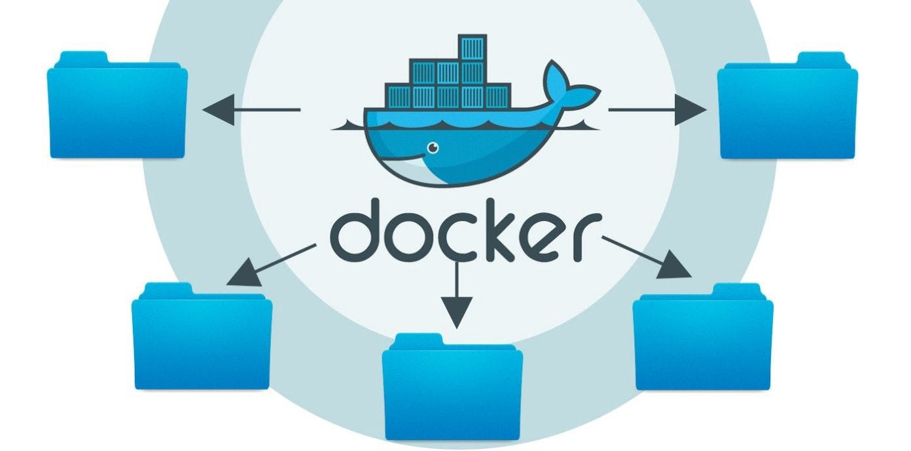
Docker Implementation
Created Dockerfile for backend
Docker image built successfully
Backend application packaged as JAR
Docker container created from image
Enables portability and consistency
2024 - RPS Consulting all rights reserved

Slide 23
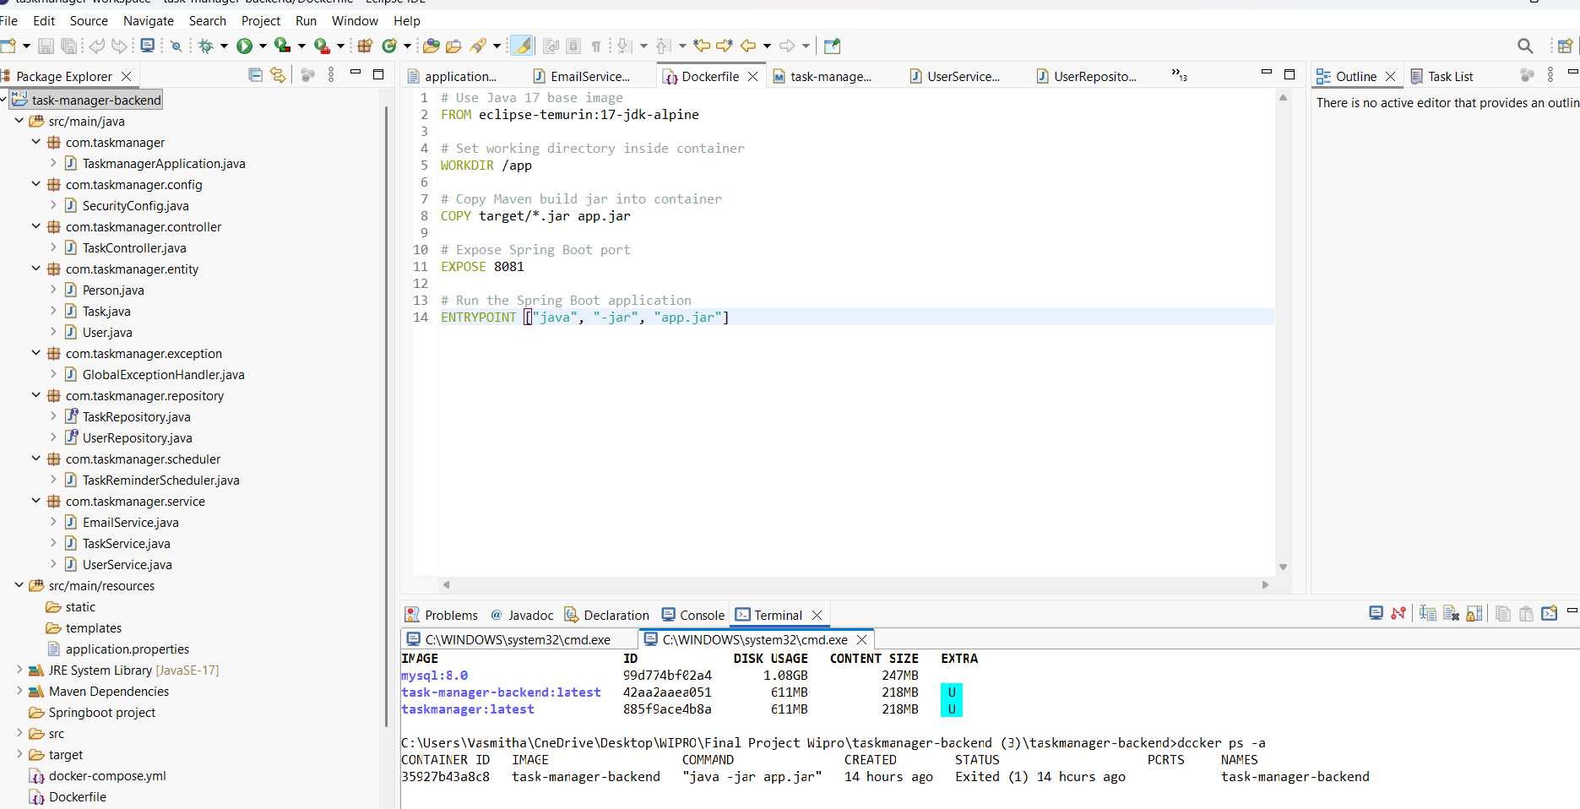
Docker Implementation
2024 - RPS Consulting all rights reserved

Slide 24
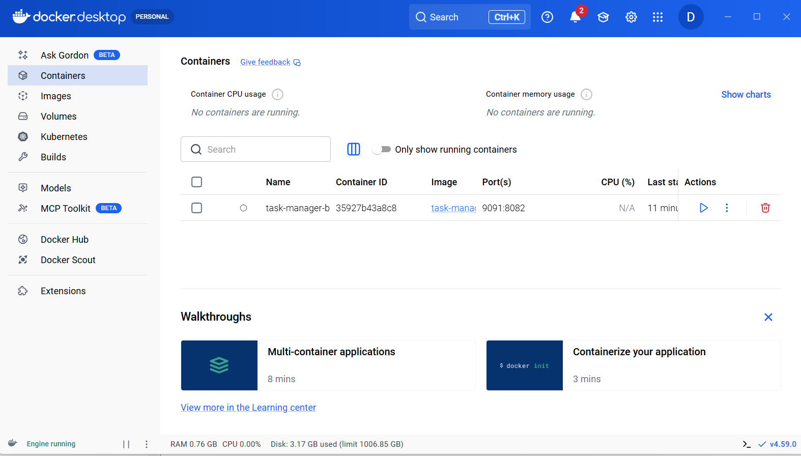
Docker Implementation
2024 - RPS Consulting all rights reserved

Slide 25
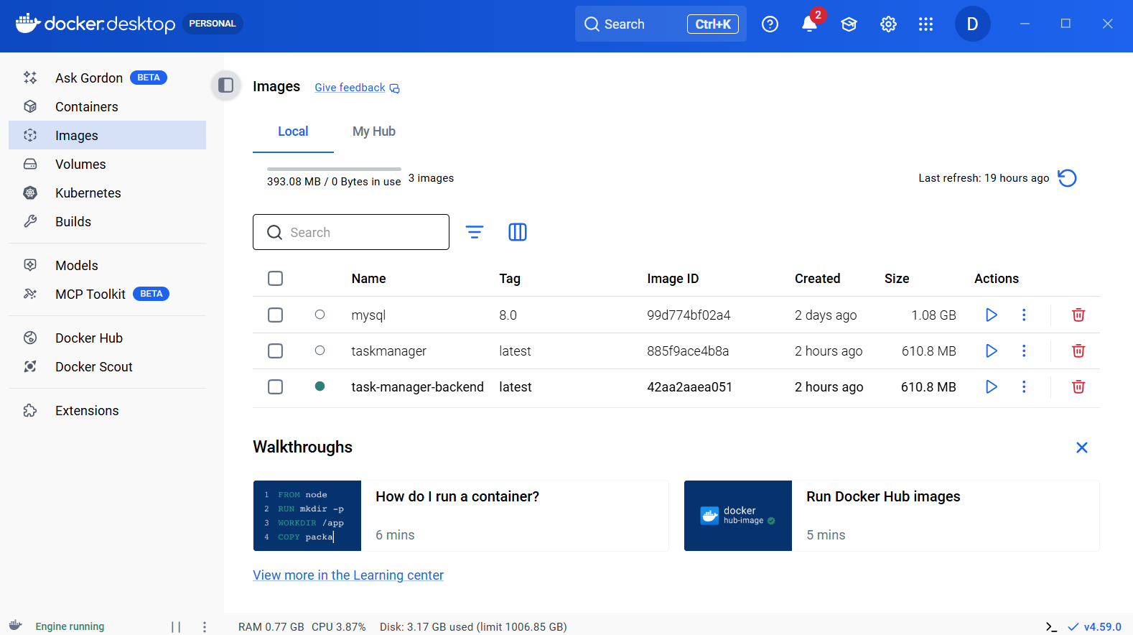
Docker Implementation
2024 - RPS Consulting all rights reserved

Slide 26
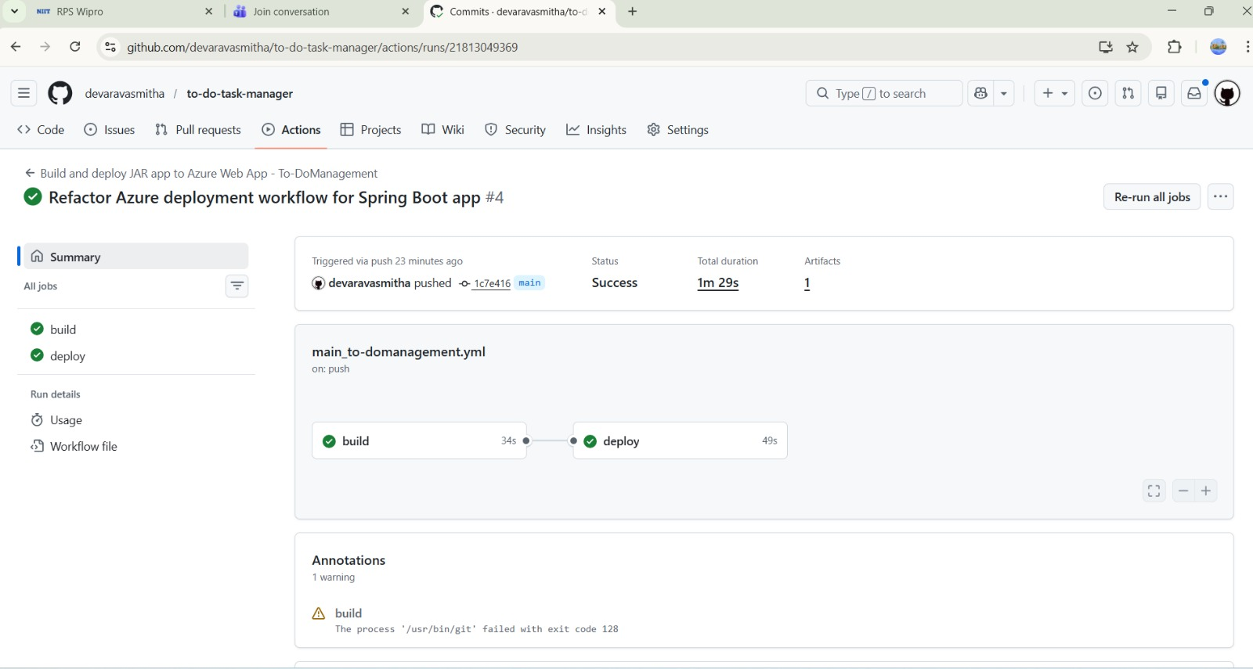
Azure Deployement
Docker image pushed to Azure
Azure Container Instance created
Backend deployed on Azure
Application accessible via public endpoint
2024 - RPS Consulting all rights reserved

Slide 27
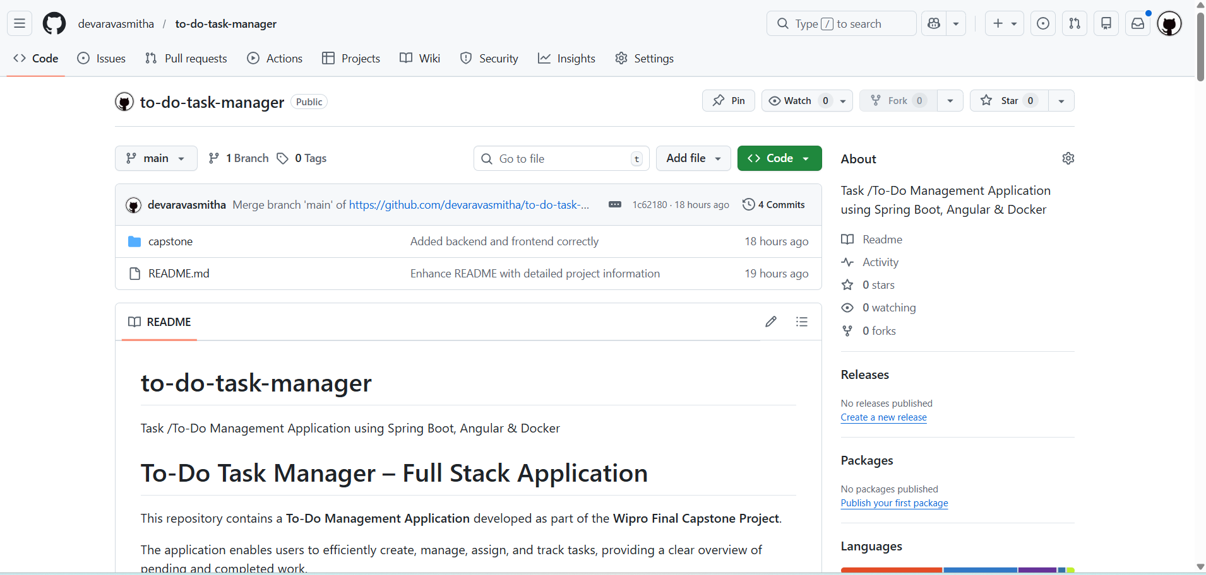
Source Code Management
GitHub used for version control
Proper project structure maintained
Meaningful commit messages
README file included with setup instructions
2024 - RPS Consulting all rights reserved

Slide 28
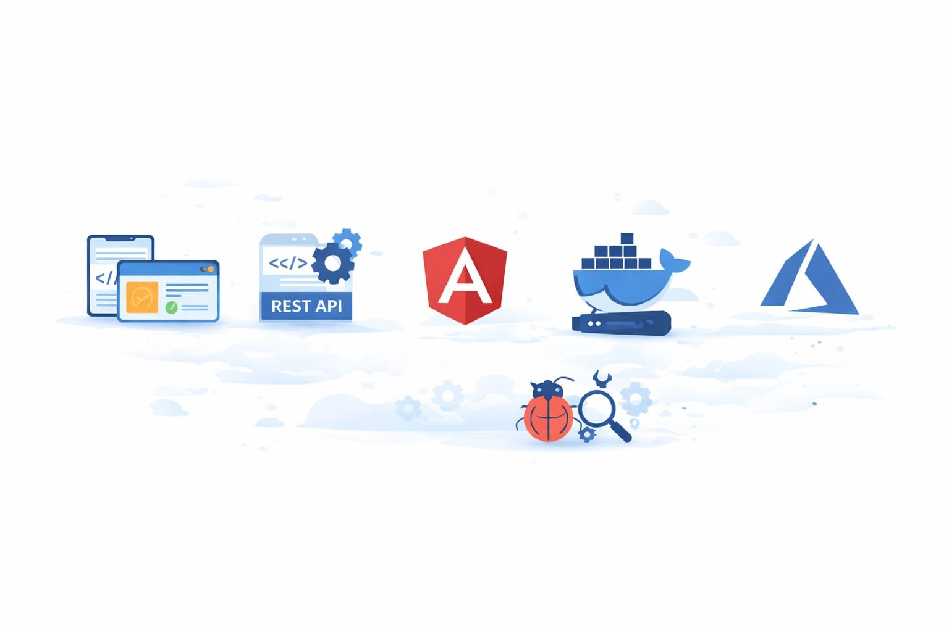
Learning Outcomes
Full-stack application development
REST API design using Spring Boot
Angular frontend development
Docker containerization
Azure cloud deployment
Debugging and problem-solving
2024 - RPS Consulting all rights reserved

Slide 29
Conclusion
The Task Management Application provides an efficient and user-friendly solution for organizing daily tasks by allowing users to create, update, delete, and track tasks based on their completion status and due dates. By integrating an Angular-based frontend with a Spring Boot backend, the system ensures smooth interaction, secure data handling, and reliable persistence using Spring Data JPA. The application improves productivity by offering clear visibility of pending and completed tasks through filtering and status updates. Overall, this project demonstrates a practical full-stack implementation that follows real-world development practices and serves as a strong foundation for future enhancements such as notifications, advanced analytics, and cloud scalability.
2024 - RPS Consulting all rights reserved

Slide 30


